Slide 1


Companion
Saathi
Saathi is a palliative care companion that helps align cancer care with the patient's values and makes care easier to access.
OPEN THE WEBSITE - saathi.wedevit.in
Questions? Contact us
wa.me/919553321211
github.com/basithladdu/healthathon
By Zeros and Ones
Shaik Abdul Basith
Shaik Muhammad Awaiz
Dr Sharada Vinod Kutty
Dr Sujay Halkur Shankar
Shirin Ayub
Technical lead
Technical member
Doctor partner
Clinician
Medical student

Slide 2
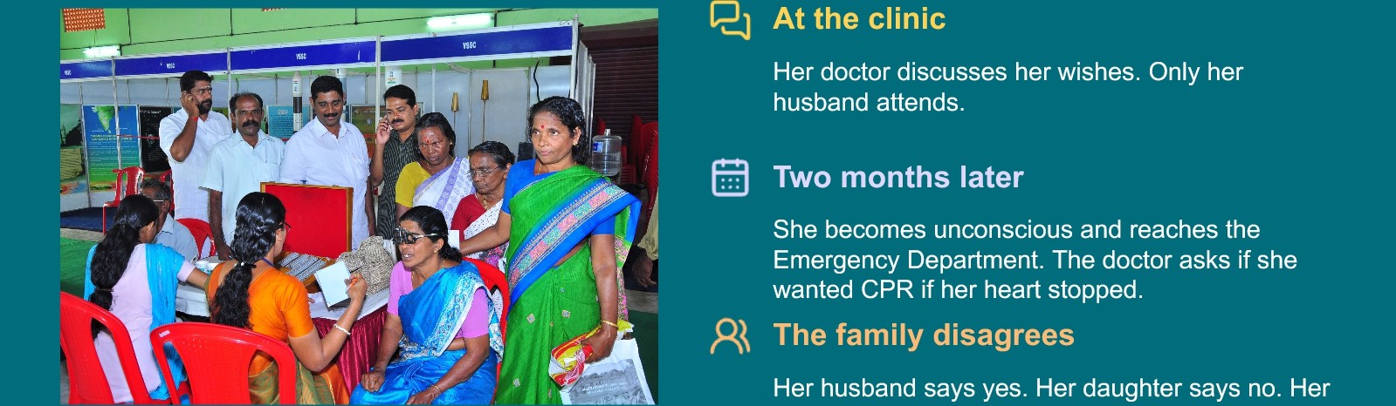
When the patient's voice is lost
A 62-year-old woman with advanced breast cancer receives best supportive care.
son calls from another city. No one can find the
earlier discussion.
Families need the patient's wishes to guide care when the patient cannot speak.

Slide 3
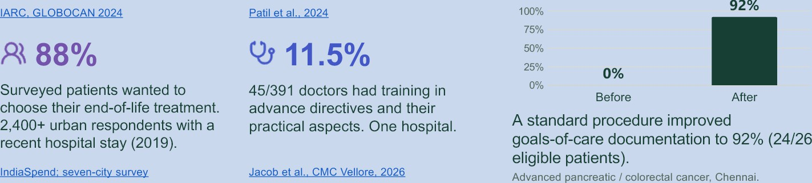
Why a palliative care companion is needed
15.6 lakh
Estimated new cancer cases in India in 2024.
*P 98.39⁰/o
Estimated unmet palliative-care need in metastatic disease across 10 cancer types.
Goals-of-care discussion
A clinician-led conversation about a patient's values, priorities and care preferences, used to agree care goals with the patient and, with consent, their family.
Different study groups. These are not results from Saathi.
Thanoasamv et al.. 2025
Proposed 60-90 day study: compare before and after
Number of patient- and doctor-initiated goals-of-care discussions.
Number of written and signed Care Notes per cancer facility.
Time to retrieve goals-of-care discussions during an emergency.

Slide 4
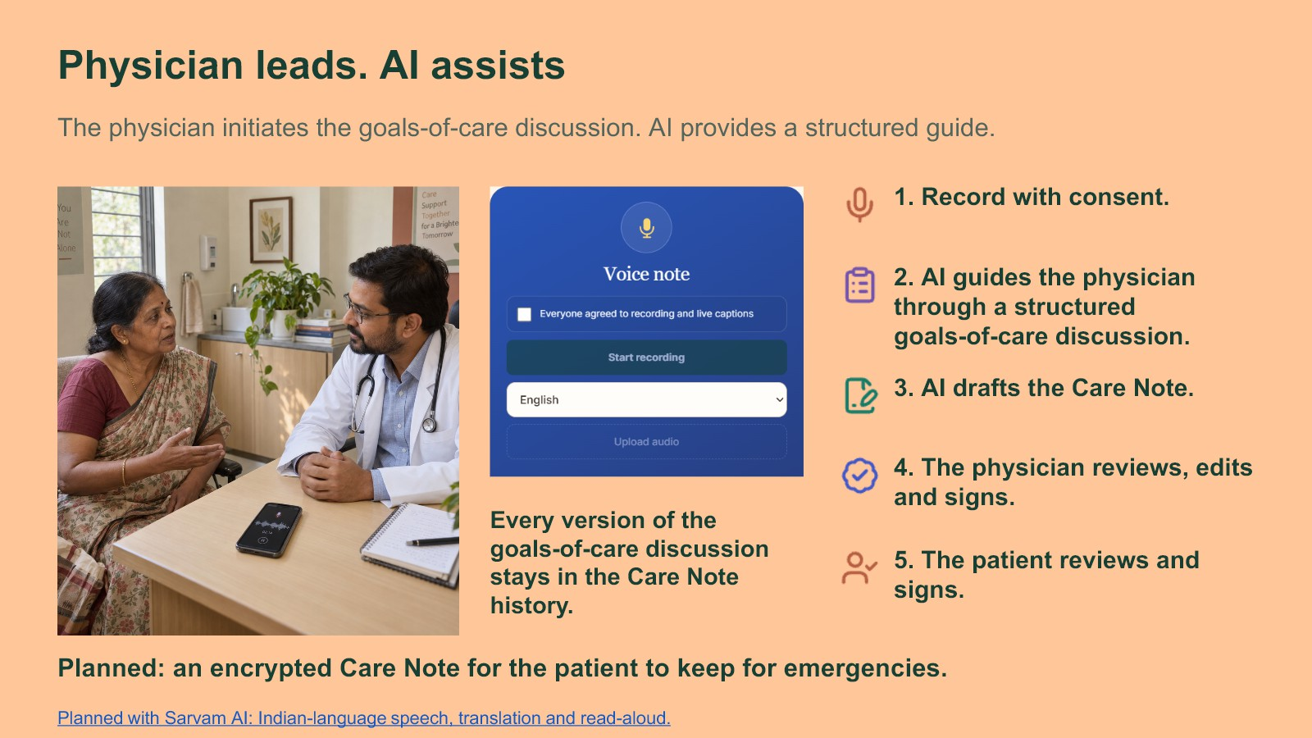

Slide 5
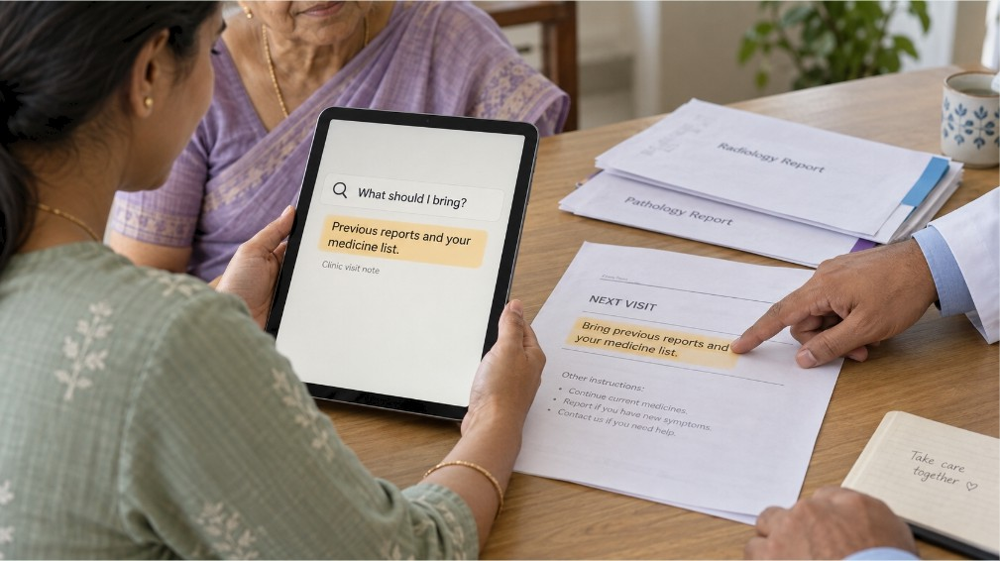





AI helps families use patient records
With the patient's permission, find answers and see the original passage.
Add a report.
Or a printed prescription.
Ask in your own words.
3. Check the original text.
Keep treatment dates in order.
Check medicine reminders before saving.

Slide 6










Saathi also keeps your cancer care in one place
Calendar
Mv documents
Find gupoon
Mv space
Visit pack
Meera's care
25 &pt :2O23
Quick access
Three sign-ins
/$* Medicines and arescrigtion reminders
{/| Visits, tests and treatment dates
Journals and svmptom tracking
Doctor
Financial tracking
OPEN - saathi.wedevit.in

Slide 7












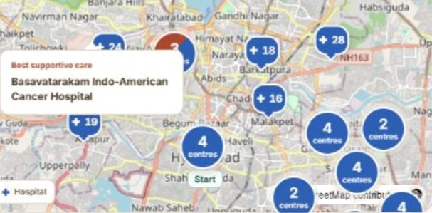


Help with palliative care near you
1. Find palliative care nearby
Find palliative-care centres and hospitals, with phone numbers and directions.
Baaavstaraknm Indo-American
Hospital
Raad No 10, Baba Hills. .-Iyaerabad 500€i3^
11.8 km About 15 min drivina no Eve gallic
Access to prescribed opioids
Ask about oral morphine, prescriptiDn documents and collection hours before travelling.
Find our cancer-s ecific su ort rog 11g
Find patient and caregiver groups for your cancer type, locally or online.
Plan travel and helg at home
Arrange a ride or ambulance, home nursing or medicine collection with your care circle.
Open the care map
Pallium India directorv

Slide 8
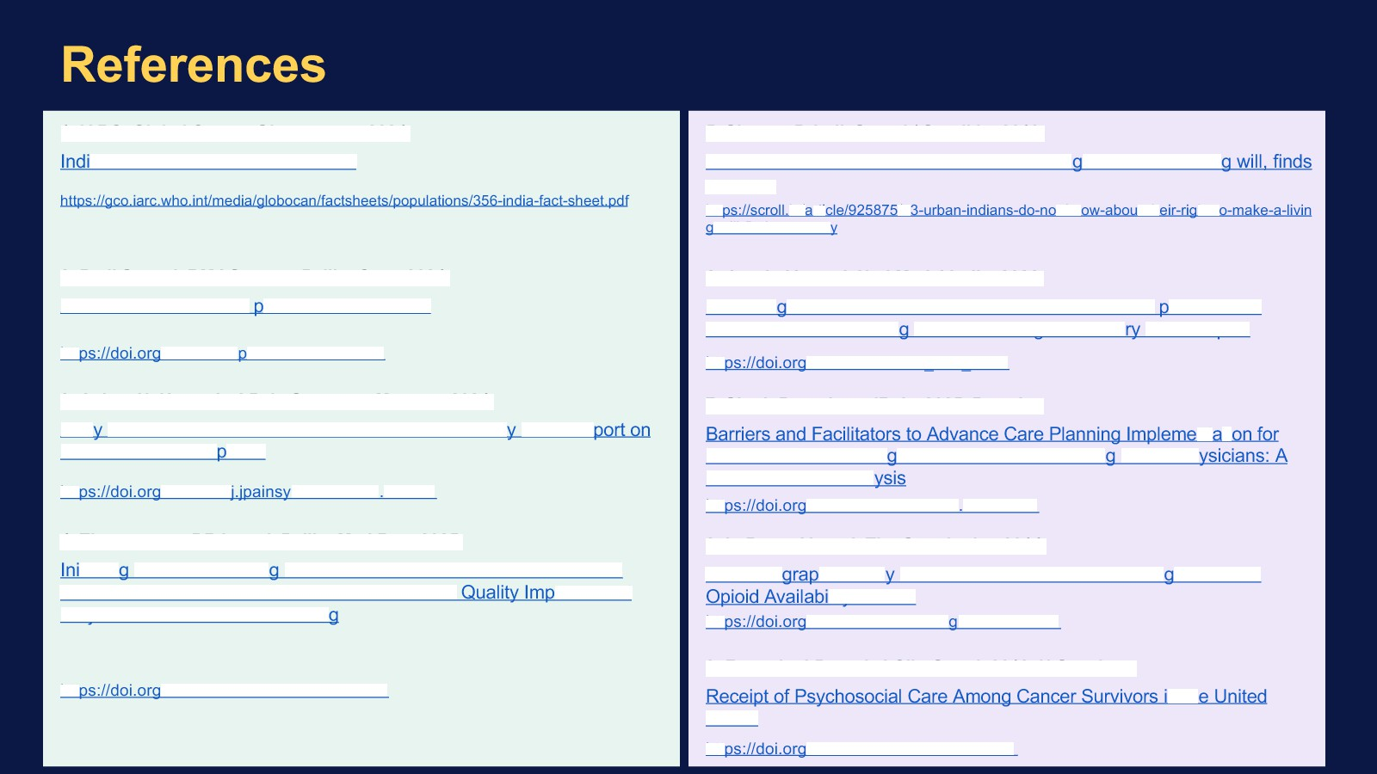


1. IARC. Global Cancer Observatory, 2024.
a: GLOBOCAN 2024 Fact Sheet
5. Sharma P. IndiaSpend / Scroll.in, 2019.
73% urban Indians do not know about their ri ht to make a livin a survev
-will-finds-a-surve
Patil S, et at. BMJ Support Palliat Care, 2024.
Unmet need for cancer alliative care in India
htt /10.1136/s care-2024-004978
Aslam N, Hayat A. J Pain Symptom Manage, 2024.
Jacob JA, et at. Natl Med J India, 2026.
Knowled e and attitude towards advance directives for atients with terminal illnesses amon doctors working in a tertia care hospital
hfl /10.25259/NMJI 817 2023
Singh P, et at. medRxiv, 2025. Preprint.
Benefits and Perce tions
Patients with Neurode enerative Diseases amon Indian Ph Mixed-Methods Anal
hfl /10.1101/2025.10.17 25338242
B. LeBaron V, et at. The Oncologist, 2014.
htt mman.2024 02.030
/10.1016/
4. Thangasamy DRJ, et at. Palliat Med Rep, 2025.
tiatin and Documentin Goals of Care Discussion in Patients with Advanced Pancreatic and Colorectal Cancers: A rovement Proiect in a Low Resource Settin
An Ethno
hic Stud of Barriers to Cancer Pain Mana ement and litv in India
/10.1634JheoncoIo ist.2013-0435
htt
9. Forsythe LP, et at. J Clin Oncol, 2013. U.S. cohort.
htt
/10.1177/26892820251392545
States
hfl
/10.1200/JCO.2012.46.2101

